Slide 1
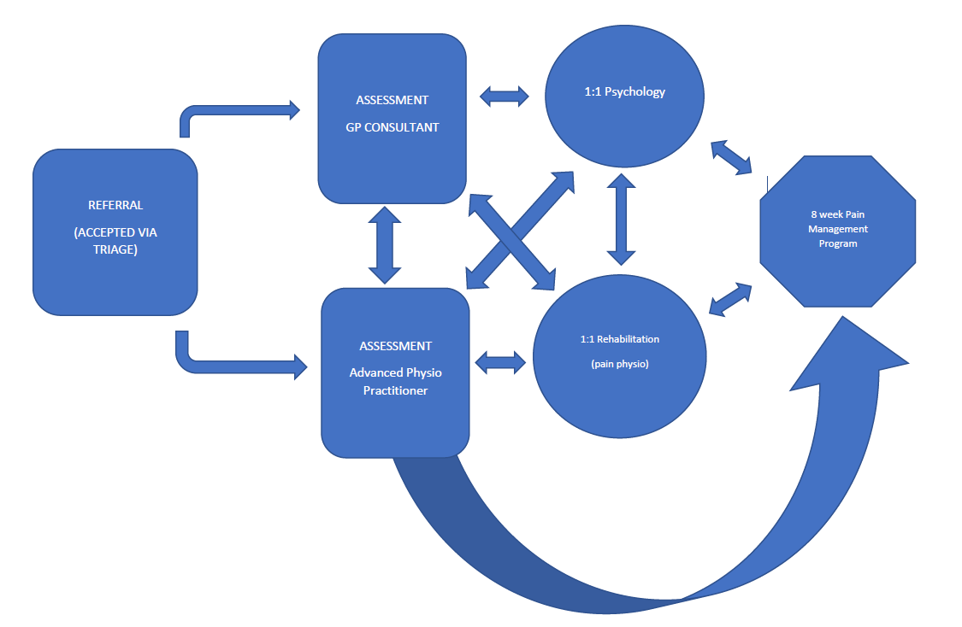
Referral Pathway
S & W Herts - Services available in South and West Hertfordshire that can help support people living with chronic pain.
Connect health chronic pain service -
Based on ACT Model – Acceptance Commitment Therapy
Bio-psychosocial model to cope and live better with chronic/ persistent pain
Group work and 1:1 options
Face to face and virtual options
Multidisciplinary: Physios/Psychologists/Pain physician
Referrals can be accepted from Primary and secondary Care professionals
Talking therapy services (IAPT) - Provided by HPFT
Symptoms of mild to moderate depression/anxiety and chronic pain
Patients who are high risk or have severe depression and/or anxiety should be referred to the Adult Community Mental Health services.
CBT approach/pacing
Patients are able to self-refer via the website or be referred by GP
Patients must be registered with a Hertfordshire or Mid Essex GP –
List of GPs provided on Website - Homepage | HPFT IAPT Services (hpft-iapt.nhs.uk)
Self-help resources
Leaflets:
• Driving and Pain information leaflet, Faculty of Pain Medicine
• Taking Opioids for Pain leaflet, Faculty of Pain Medicine
• Ten Footsteps programme - Live Well with Pain
• Medicines and their risk of addiction leaflet, MHRA
• Flippin’ Pain on-line resources
• The Pain Toolkit – online resource with guidance on managing pain. NB some content requires payment
World Health Organisation Animated Videos:
• Depression: https://www.youtube.com/watch?v=XiCrniLQGYc
• Stress: https://www.youtube.com/watch?v=I6402QJp52M
Apps available on Google Play and the Apple Store:
• Mindfulness : Headspace
• Active Walking: Get active – NHS resources

